Slide 1
ONLINE CAFÉ RESERVATION
Group No :- 6
(230 JAVA SL VA Batch)

Slide 2
GROUP MEMBERS
Barkha Soni(Team Leading) …….2563289
Bandari Sai Teja……………………2563208
Harsh Shukla……………………….. 2563578
Bhushan Yogesh Bisane……………2563092
Katta Vivek………………………...2563701
Pokala Mohan Krishna…………….2563219
Pottapegula Sunil…………………..2562869

Slide 3
CONTENT
INTRODUCTION
PROJECT MODULES
TECHNOLOGIES USED
FLOWCHART FOR USER END
FLOW CHART FOR ADMIN END
SCREENSHOTS

Slide 4
INTRODUCTION
Today I will introduce you to a comprehensive solution that aims to transform the way cafes manage their operations and enhance their customer experience. The “Online Café Reservation," a sophisticated application developed using the powerful combination of Spring Boot for the backend and Angular for the frontend.

Slide 5
PROJECT MODULES
USER END
User login
Registering new user
Change password
Update user profile
Booking the table
Showing the list of reserved tables
Experience the seamless online reservation process
ADMIN END
Login to Portal
Create Admin Account
Add or remove new delicacy to the menu and to read from the contact-form.
Edit delicacies from the menu card details like item name, price, and description to keep the food item information updated with the current prices.
Enable or disable the food items in the cafe.
Accepting or denying the request for reserving the table.

Slide 6
TECHNOLOGIES USED
FRONTEND -: Angular
SERVER SIDE -: Spring Boot, Spring Boot Data JPA
BACKEND -: MYSQL, Hibernate
SERVER -: Tomcat

Slide 7
USER END FLOWCHART
ABOUT US
REGISTER NEW USER
CONTACT US
MENU
USER
If correct email-id & password
BOOK TABLE
LOGIN
SEE RESERVED TABLE
Error message
UPDATE PROFILE
CHANGE PASSWORD

Slide 8
ADMIN END FLOWCHART
ACCEPT OR DENY REQUEST
ADD ITEMS TO MENU
If correct email-id & password
ADMIN
LOGIN
SEE ITEM LIST AND MODIFY OR DELETE IT
Error message
MODIFY ITEM STATUS
CONTACT DETAILS

Slide 9
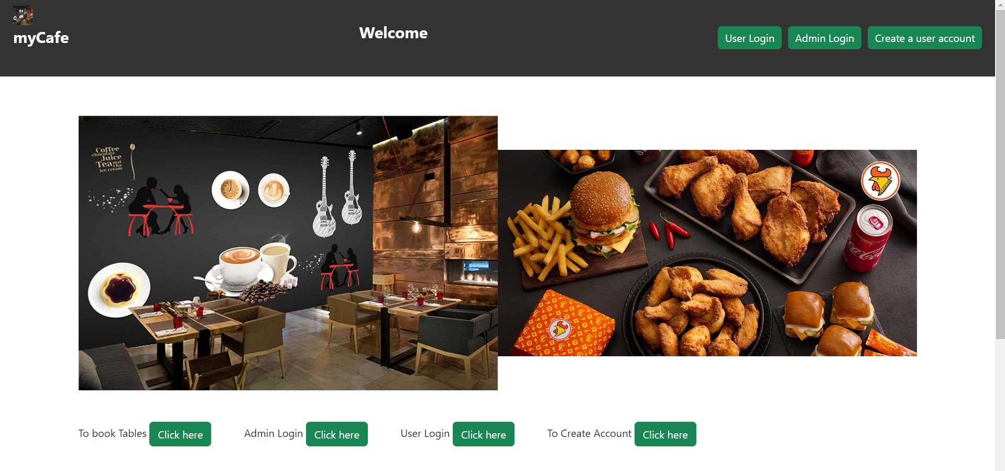
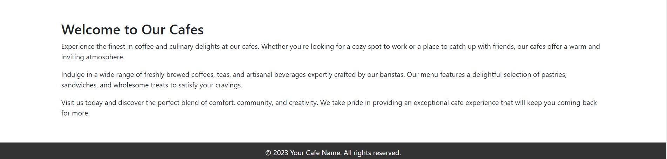
WELCOME PAGE

Slide 10
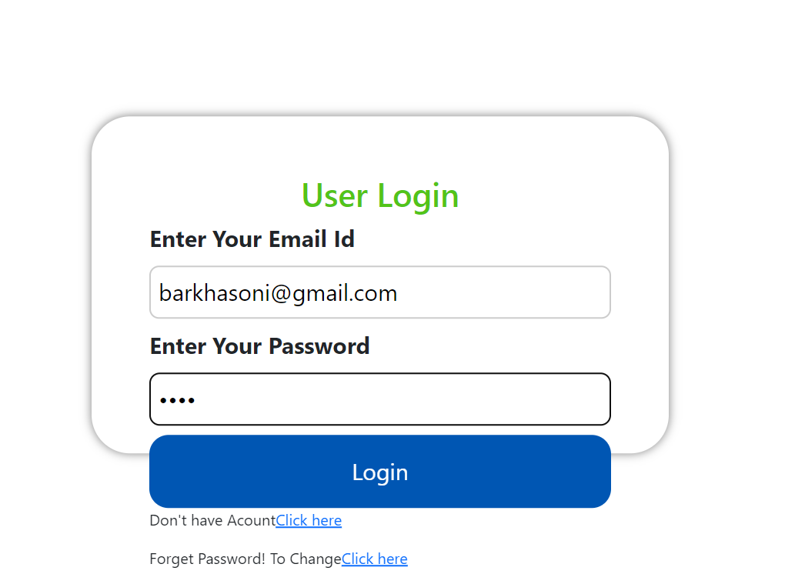
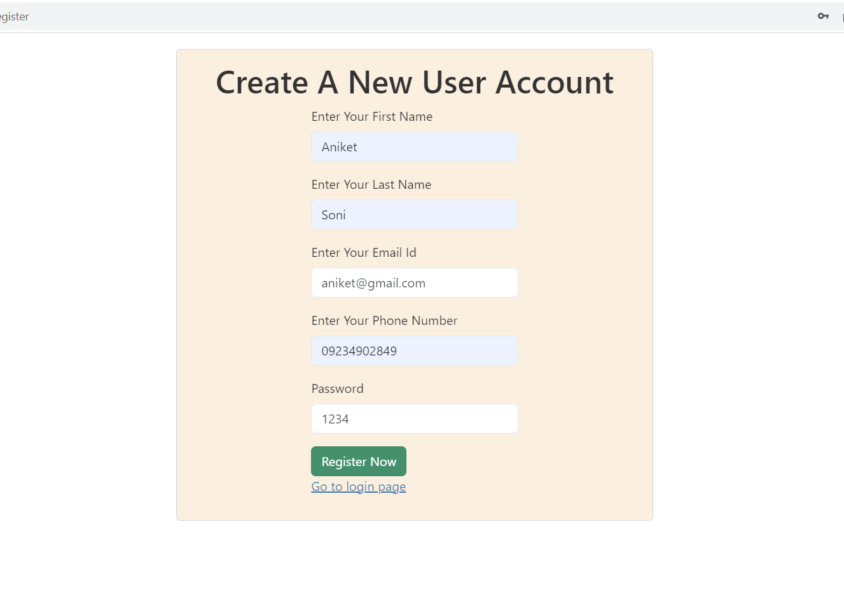
USER PROTAL User Login And Register New User

Slide 11
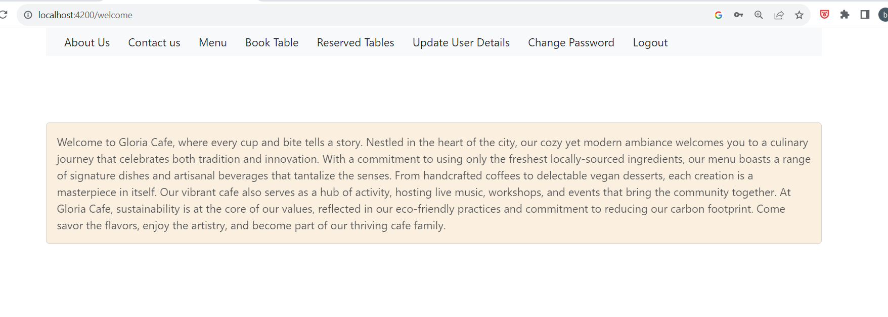
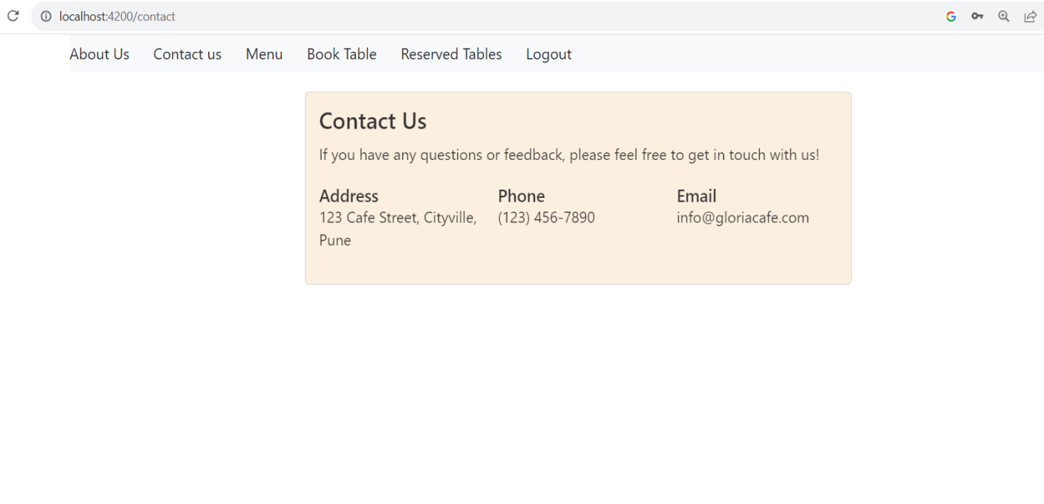
User End Portal

Slide 12
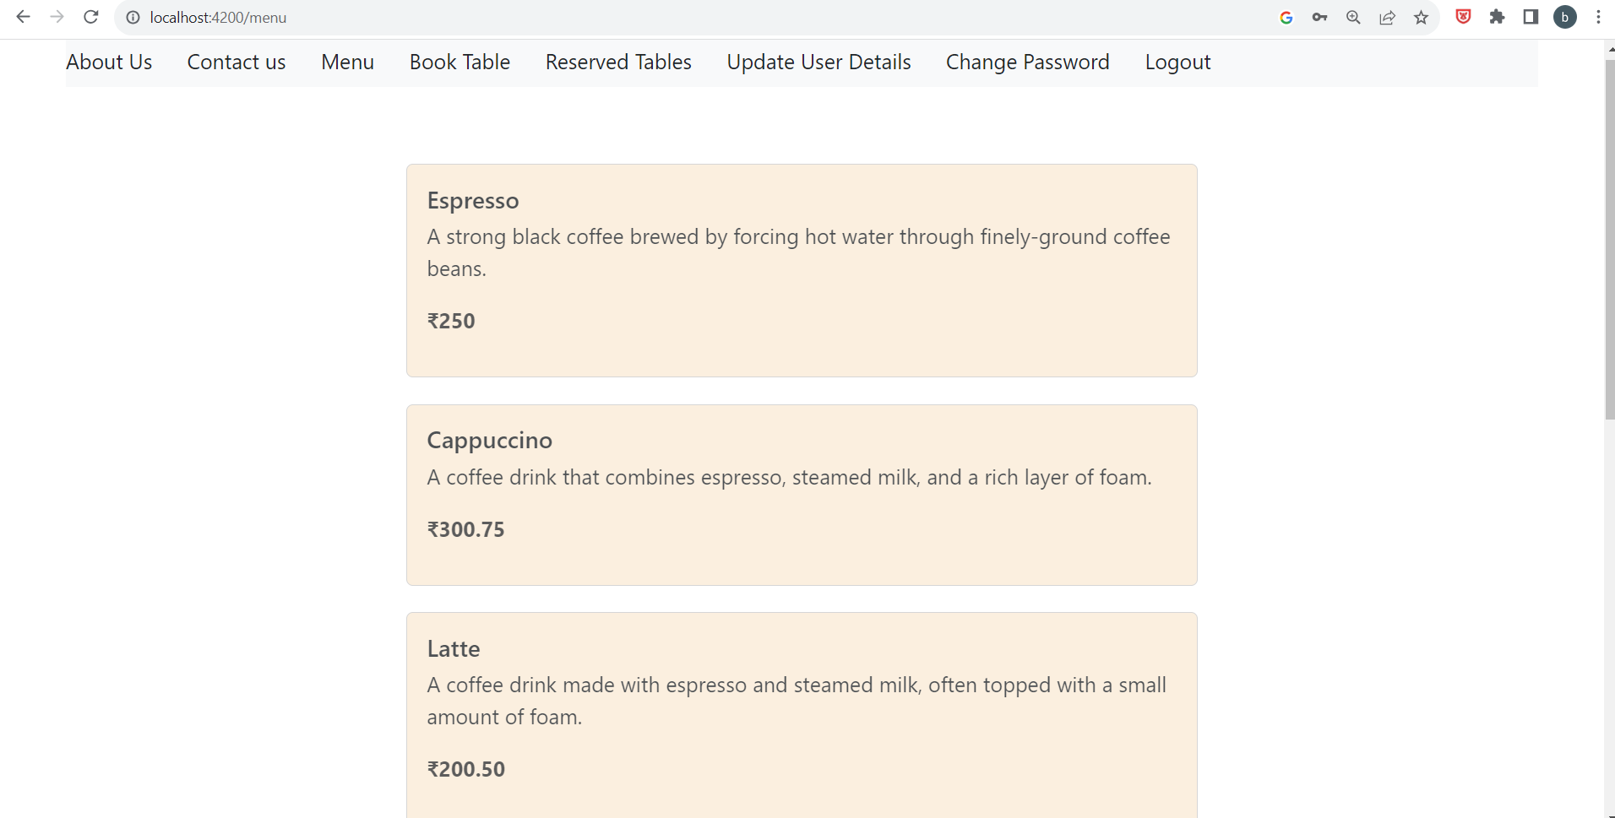

Slide 13
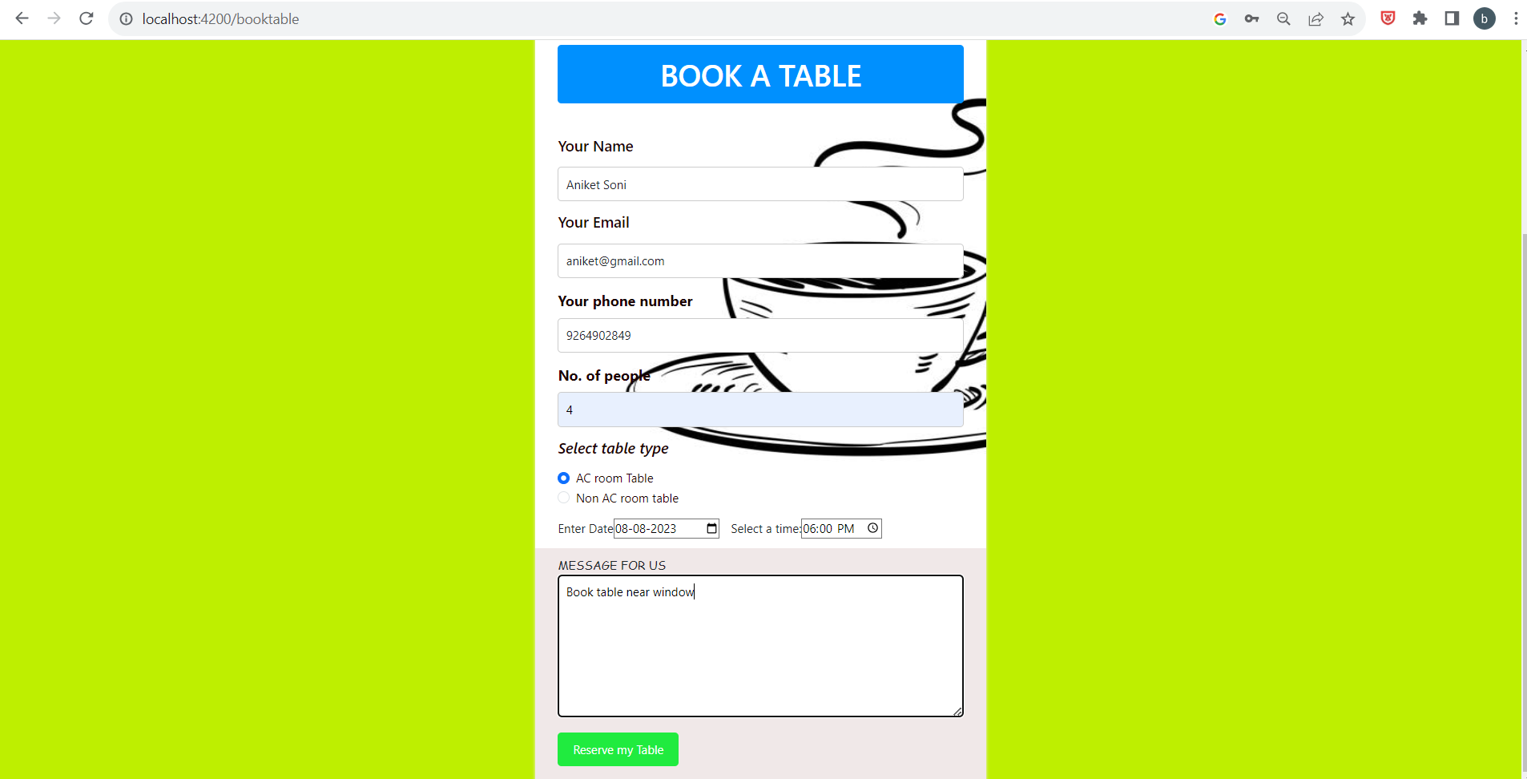
Sending request to book table

Slide 14
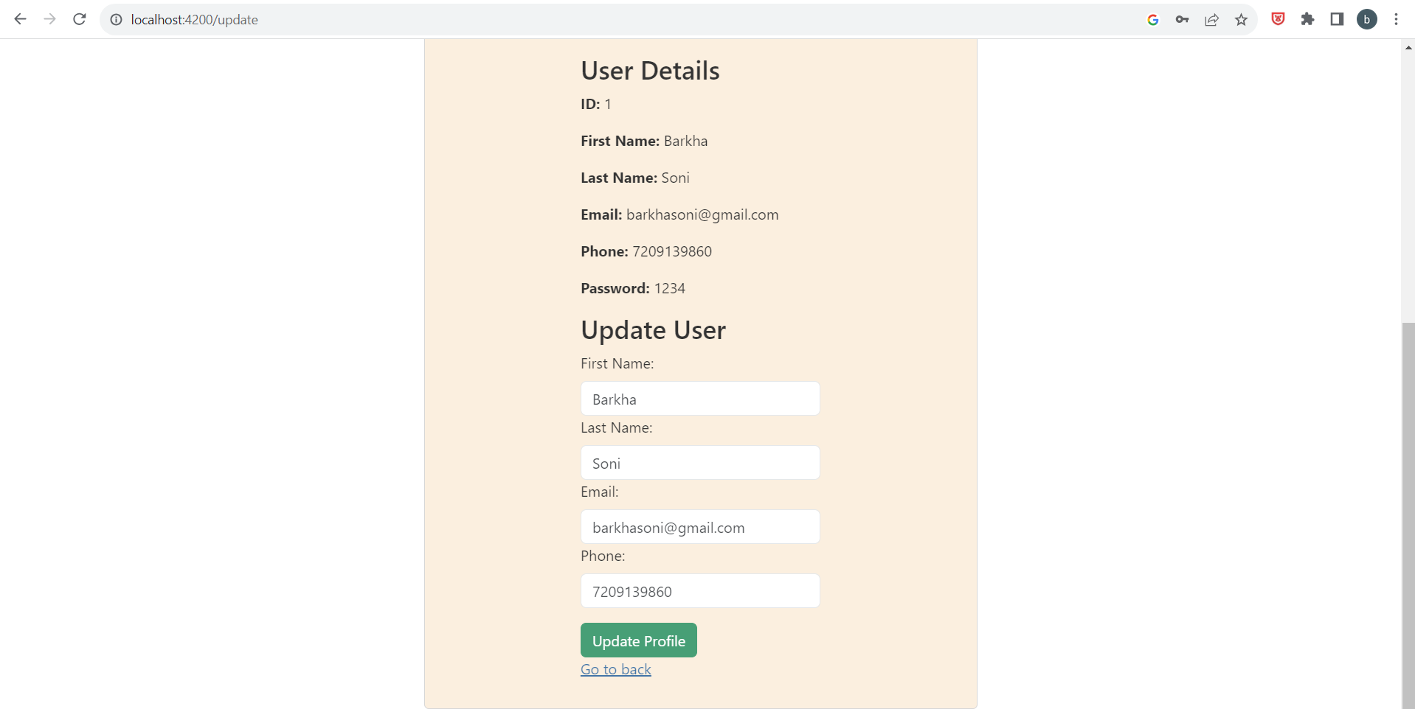
Update User Profile

Slide 15
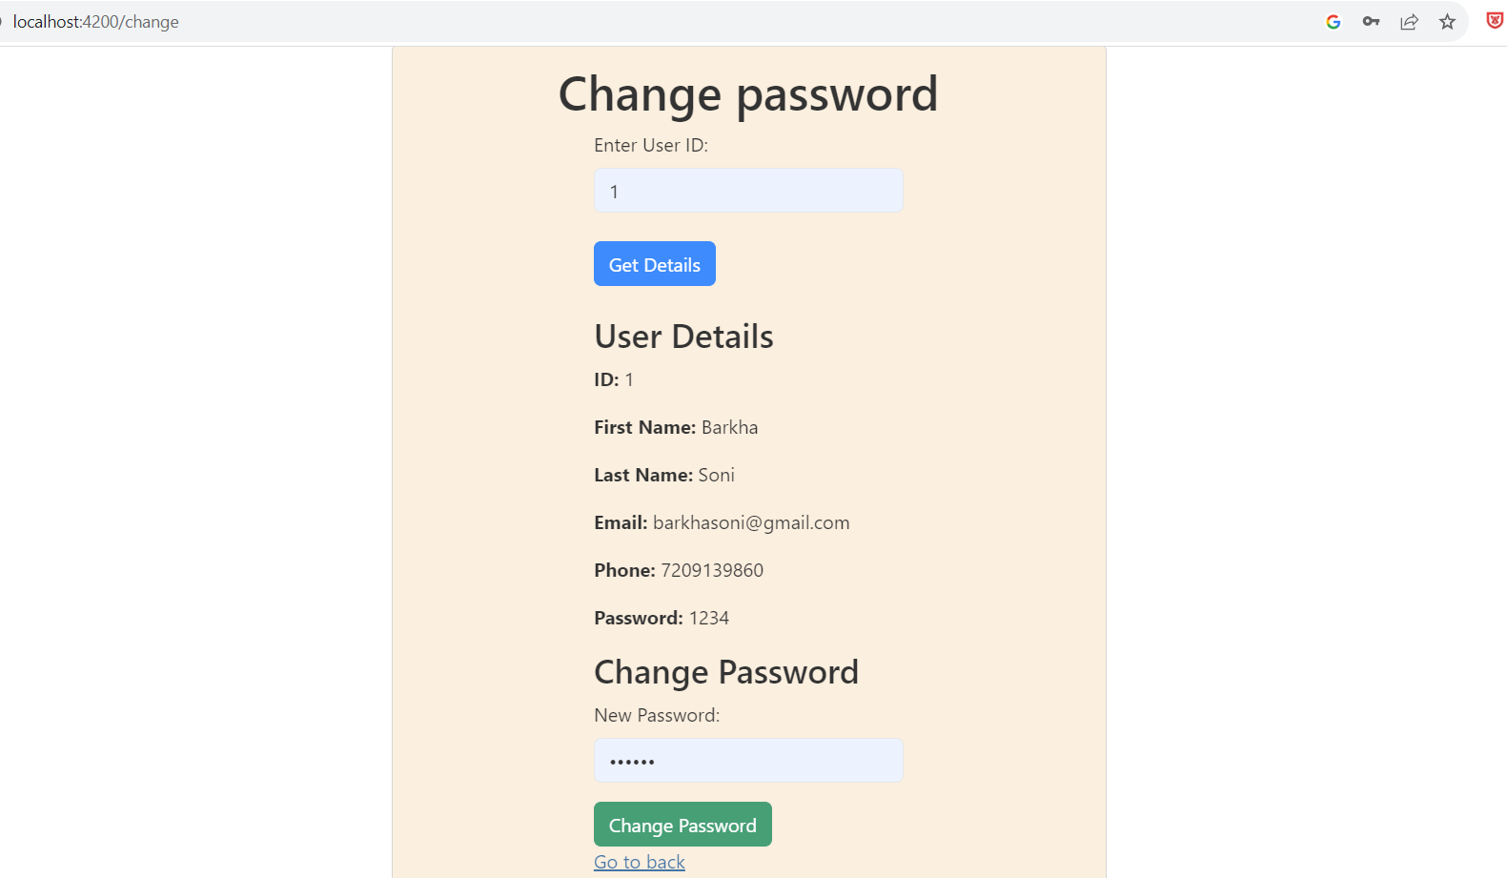
Change Password

Slide 16
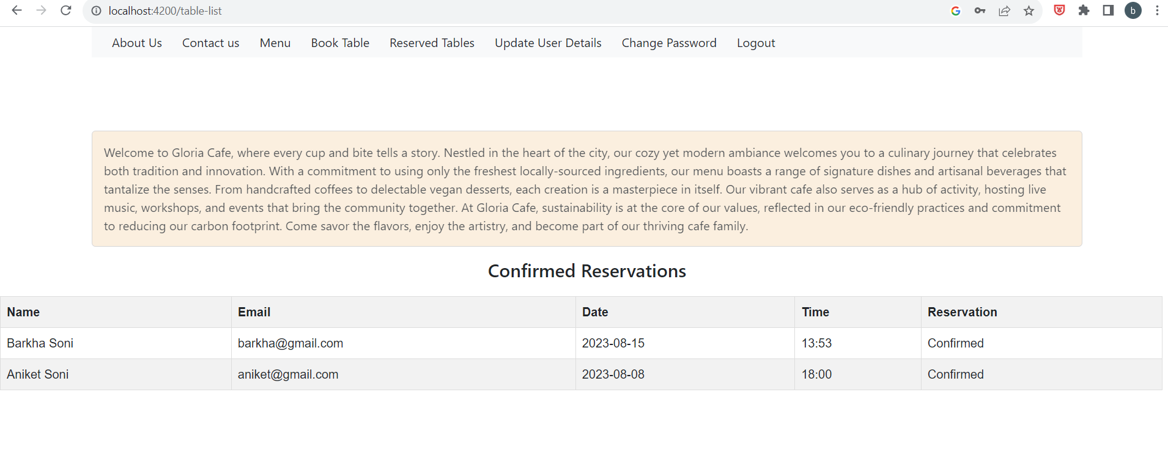
Showing List Of Reserved Tables

Slide 17
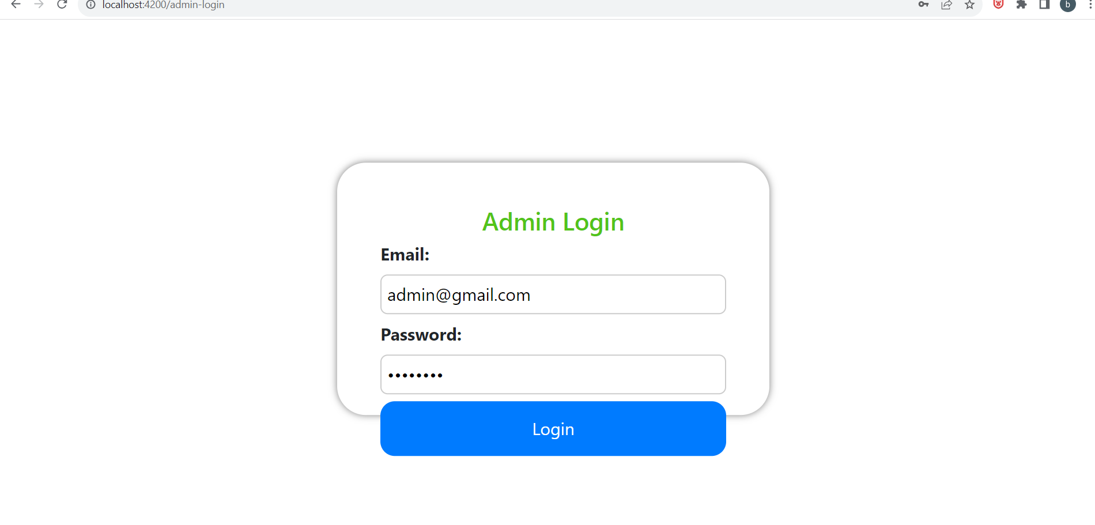
ADMIN PORTAL Login to Admin Portal

Slide 18
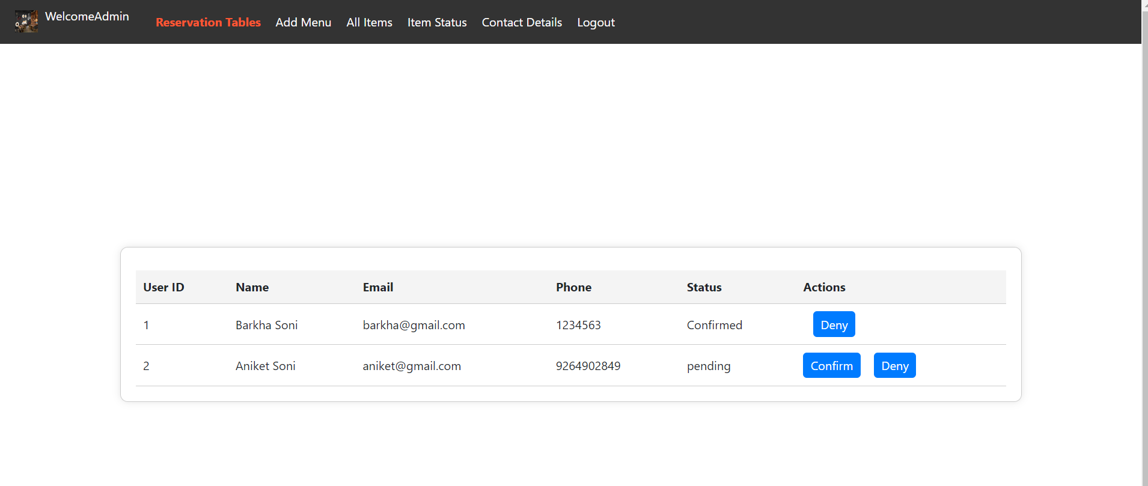
Accepting or Denying The Table Reservation Request

Slide 19
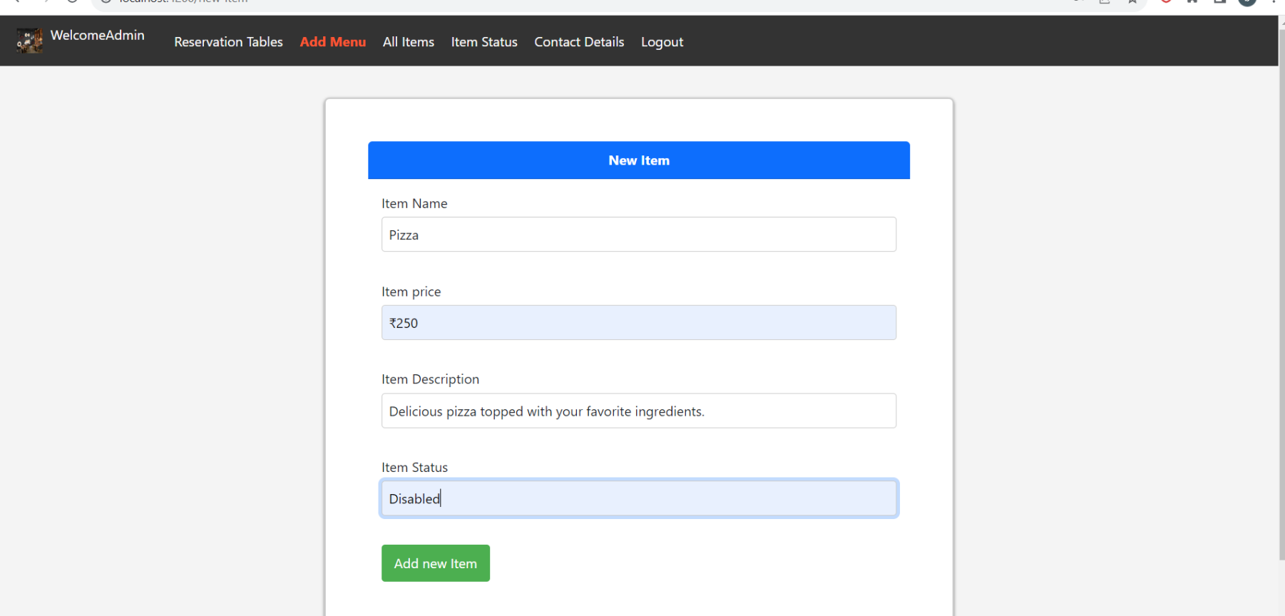
Adding Items

Slide 20
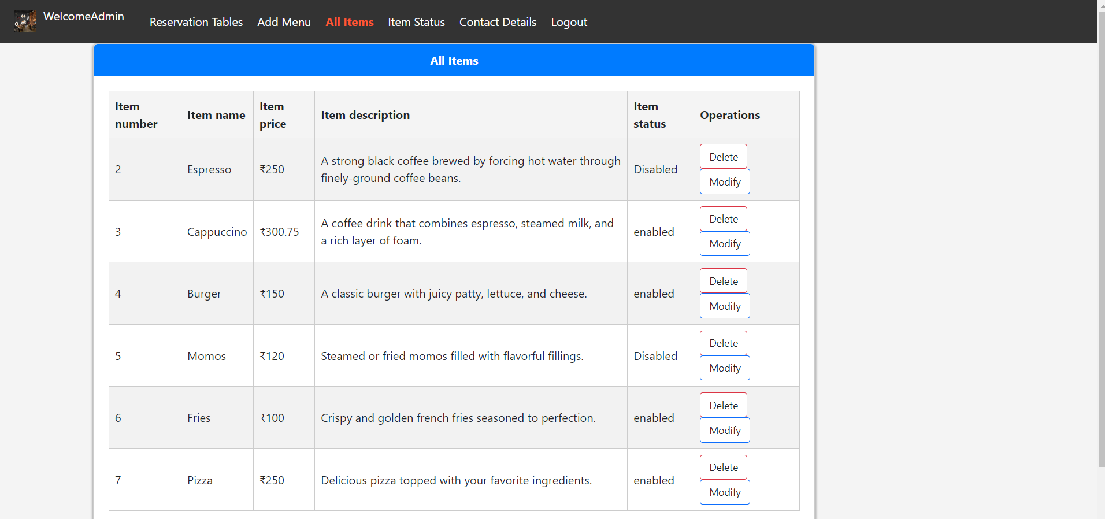
List Of All Items

Slide 21
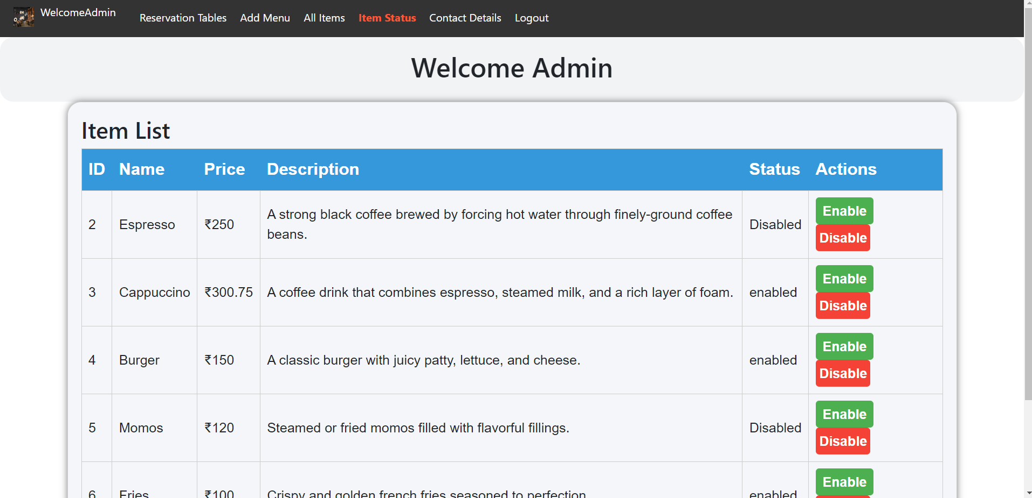
Enabling Or Disabling The Items

Slide 22
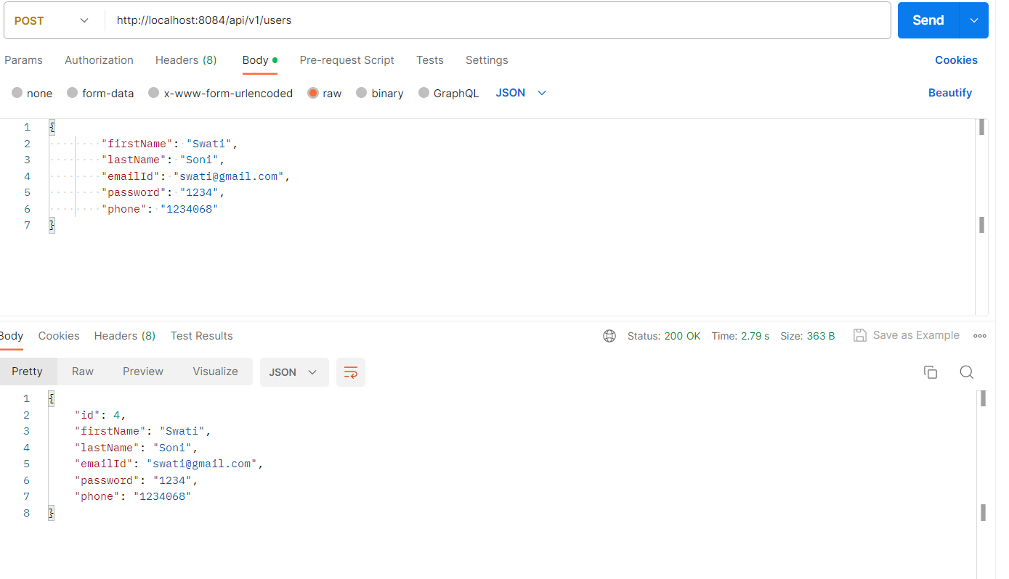
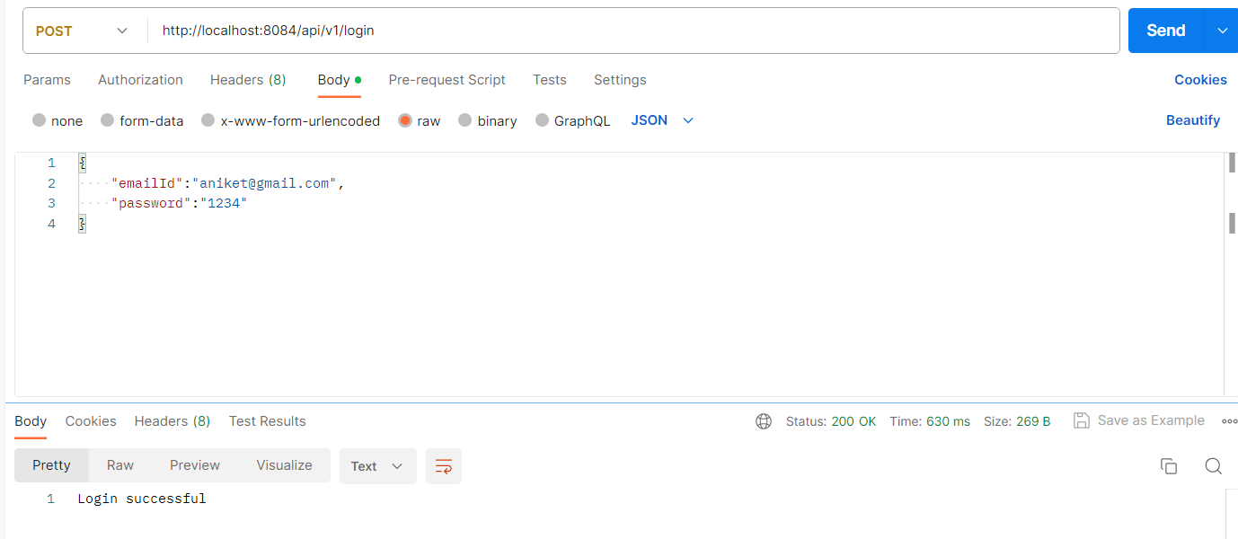
Testing User portal
User Registration User Login

Slide 23
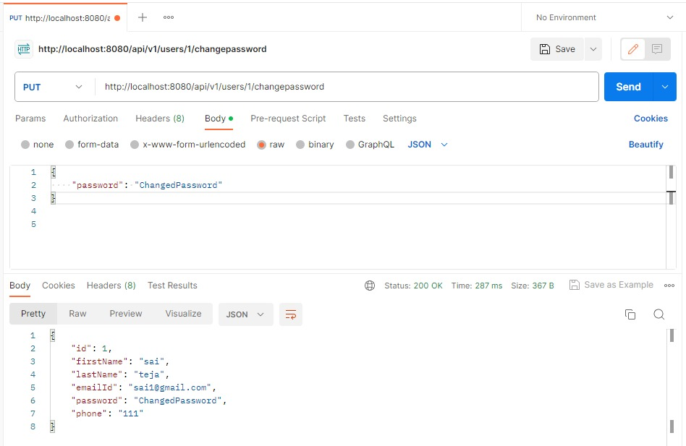
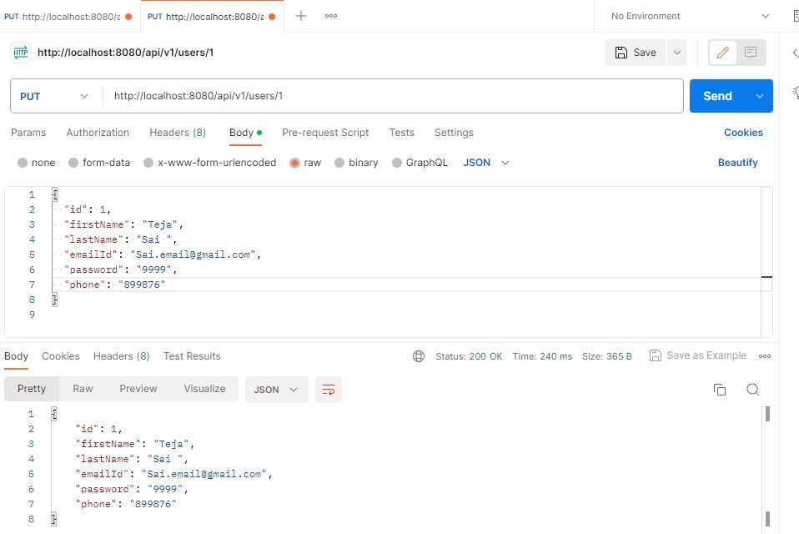
Change Password
Update profile

Slide 24
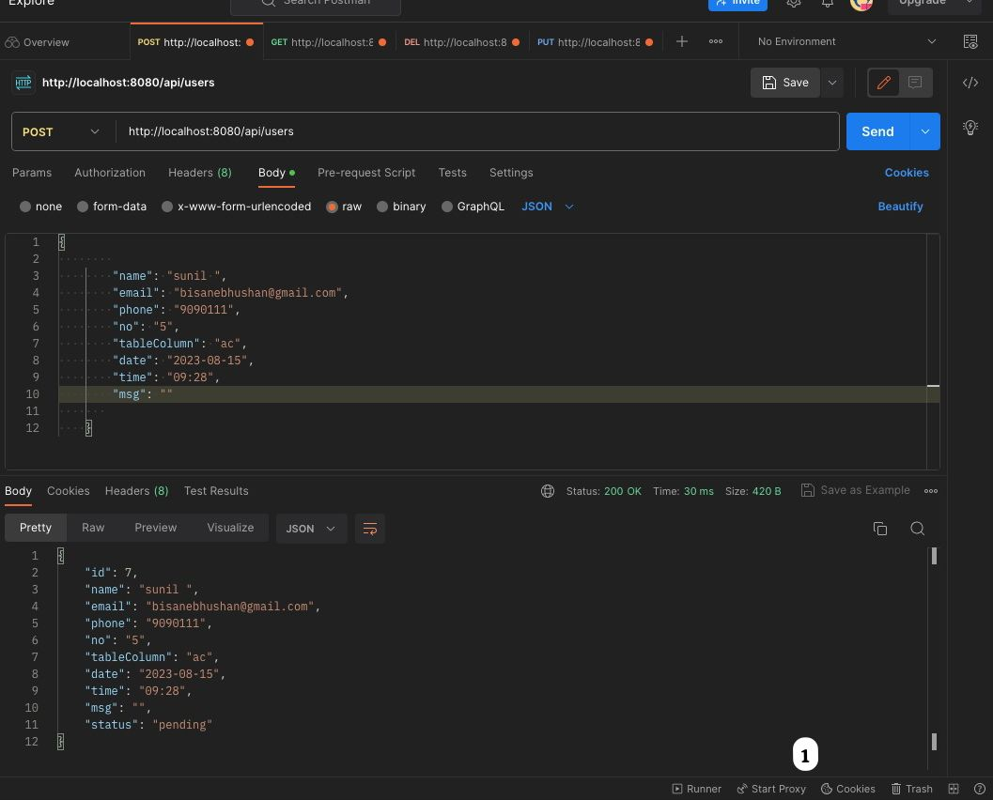
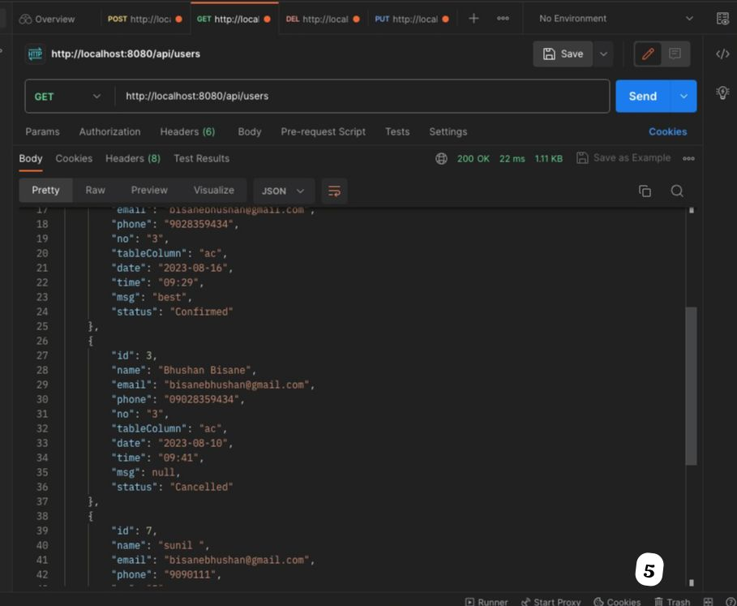
Adding request for tables
Getting list of requested tables

Slide 25
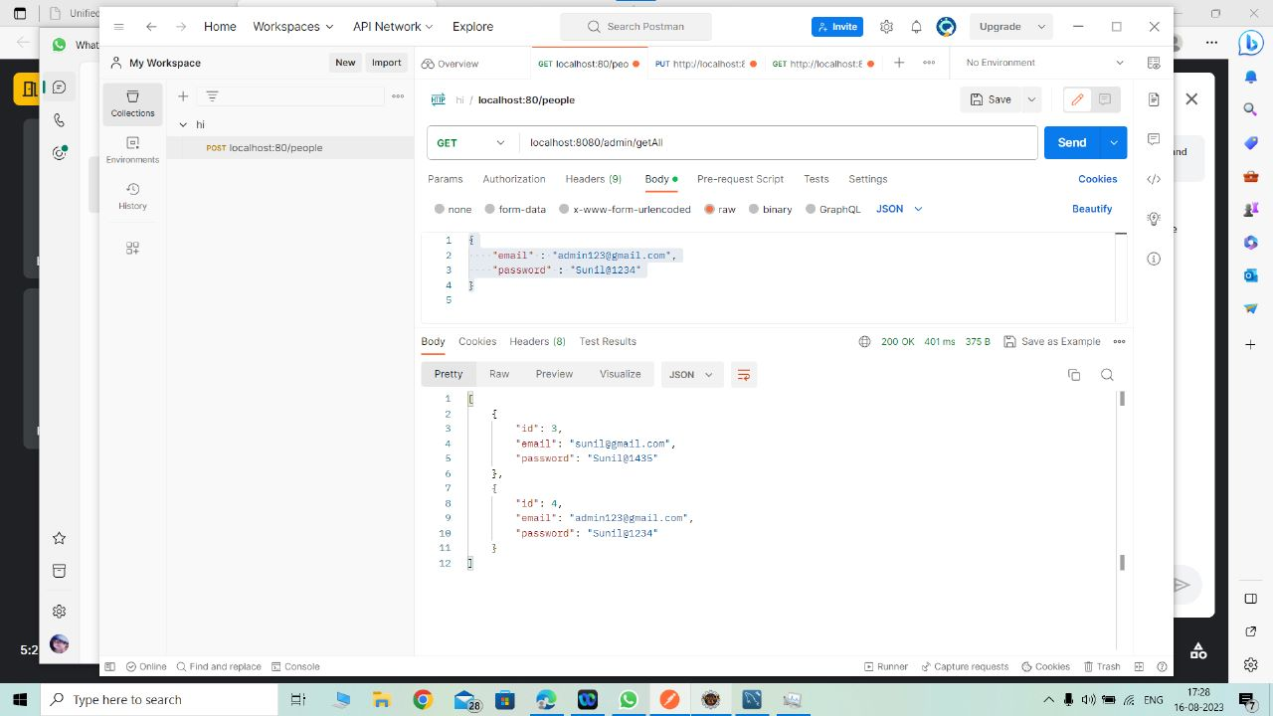
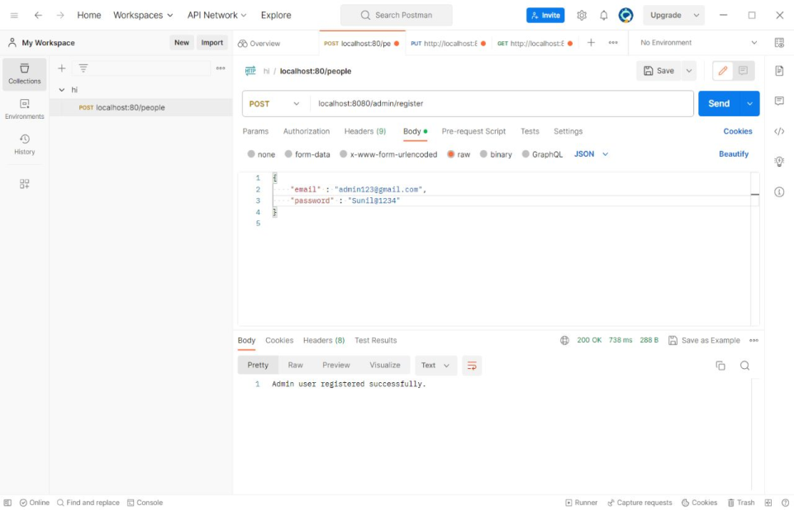
Admin portal testing
Admin Login Admin Register

Slide 26
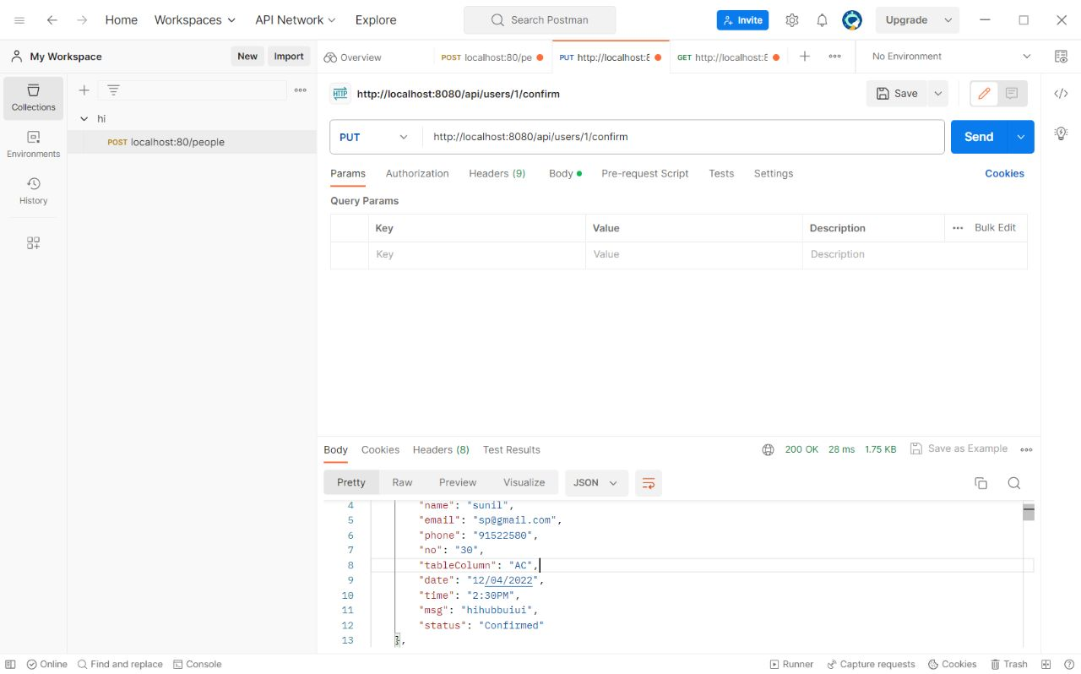
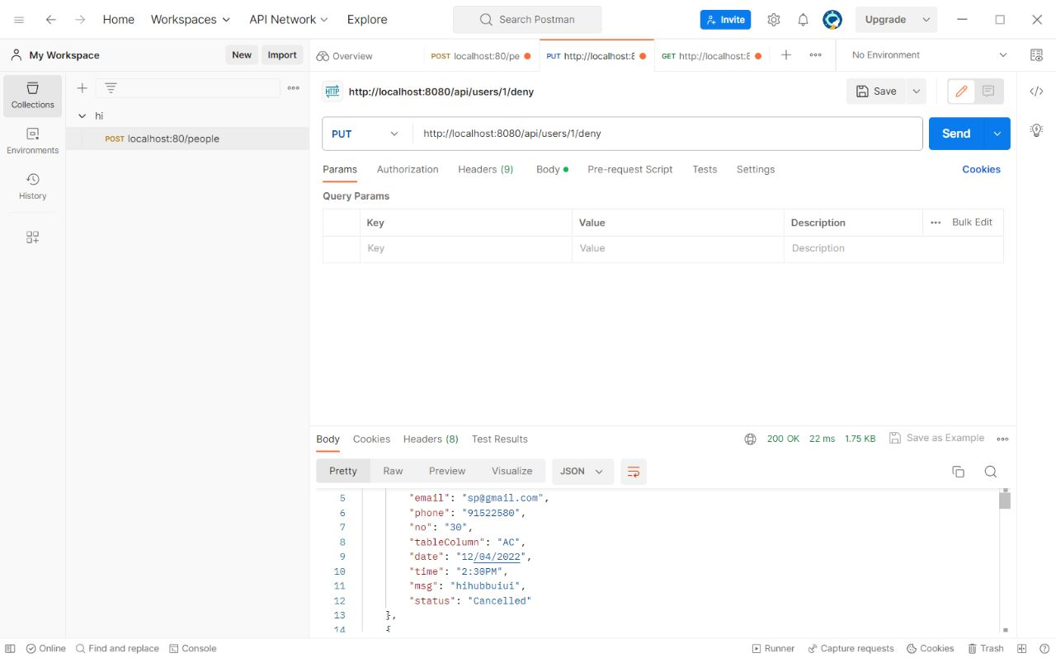
Table confirmation
Confirmation cancelled

Slide 27
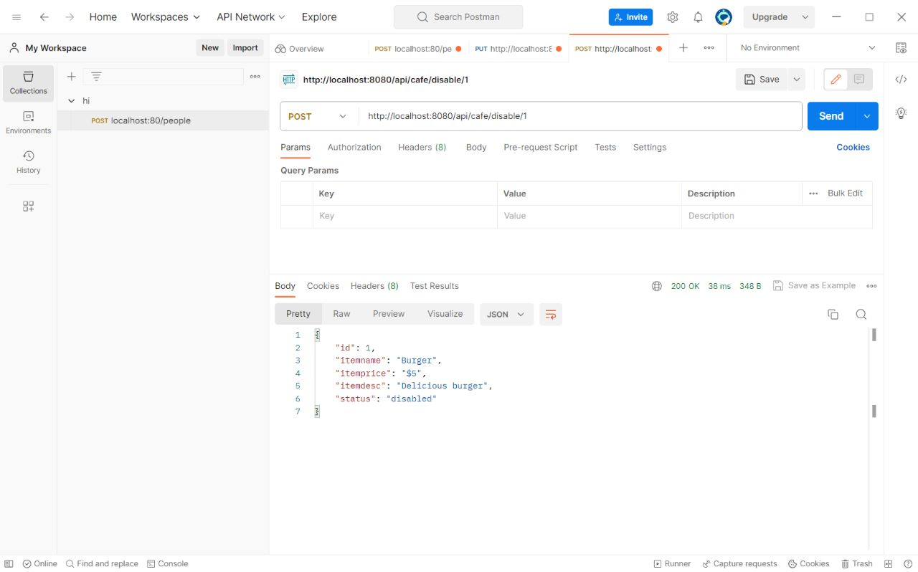
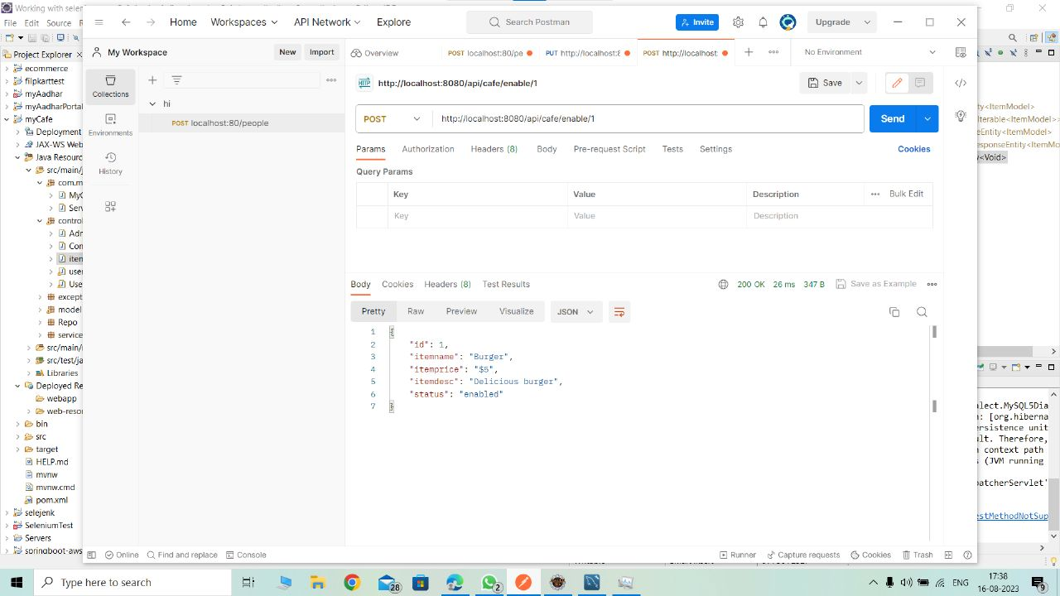
Enabling and Disabling Item

Slide 28
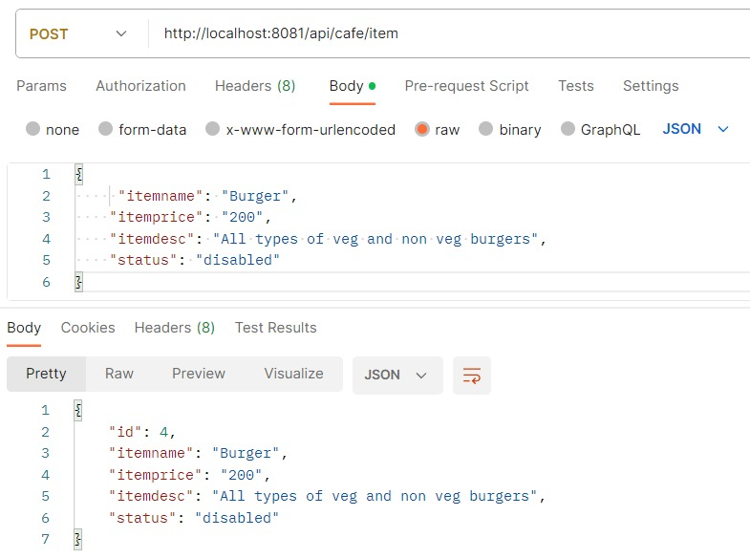
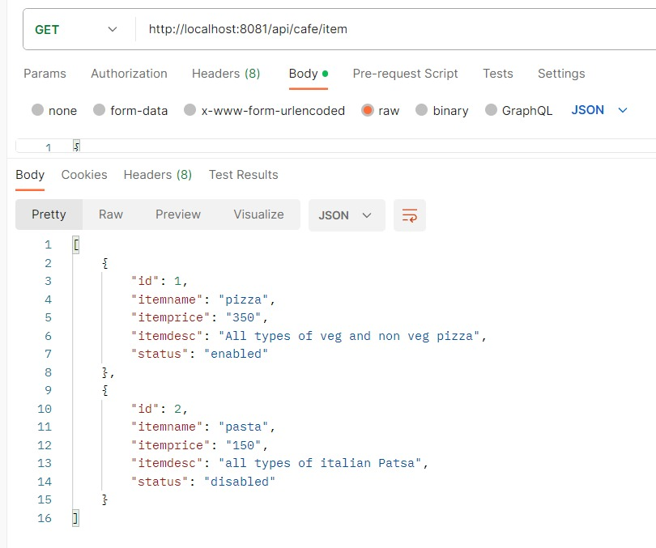
Adding new item to the menu
Listing item to the menu

Slide 29
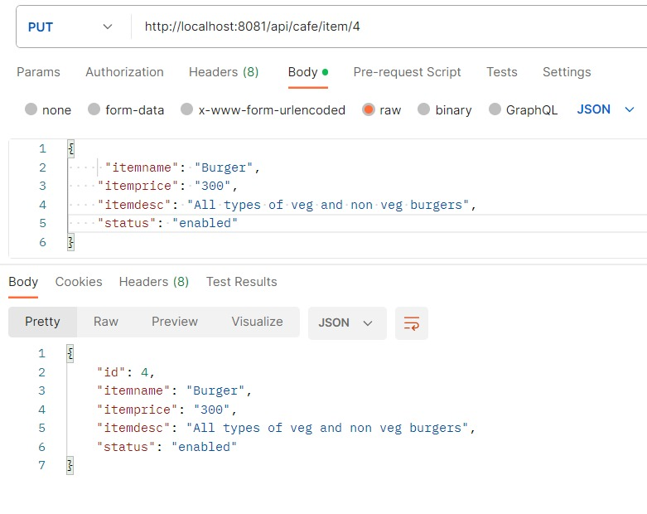
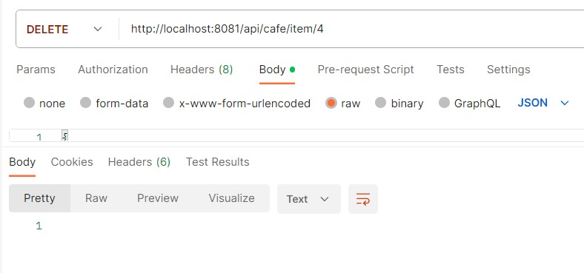
Modifying item
Deleting item

Slide 30
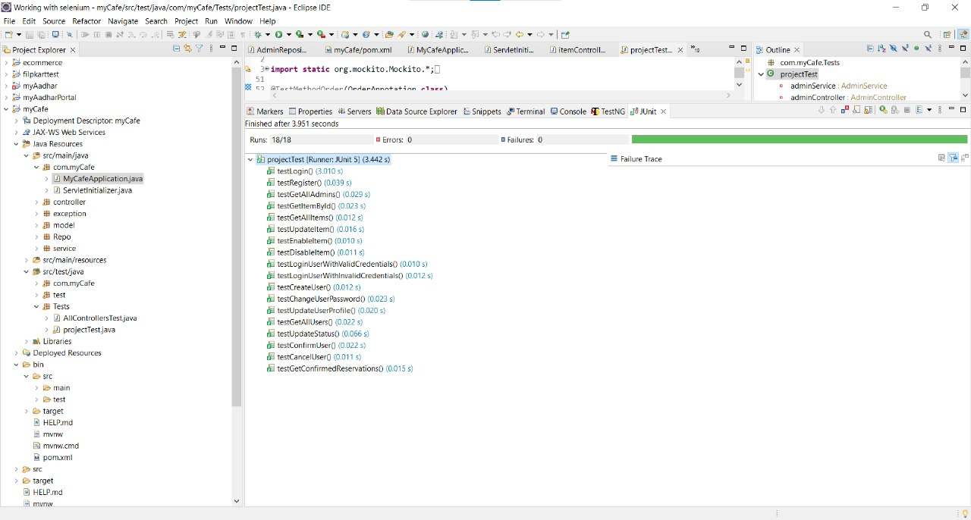
JUnit Testing

Slide 31
THANK YOU

